Slide 1
Design and Analysis of Algorithms All-pairs shortest paths
Presented By Muhammad Atif Tahir
Slides from: Haidong Xue and Dr. Fethi Jarray

Slide 2
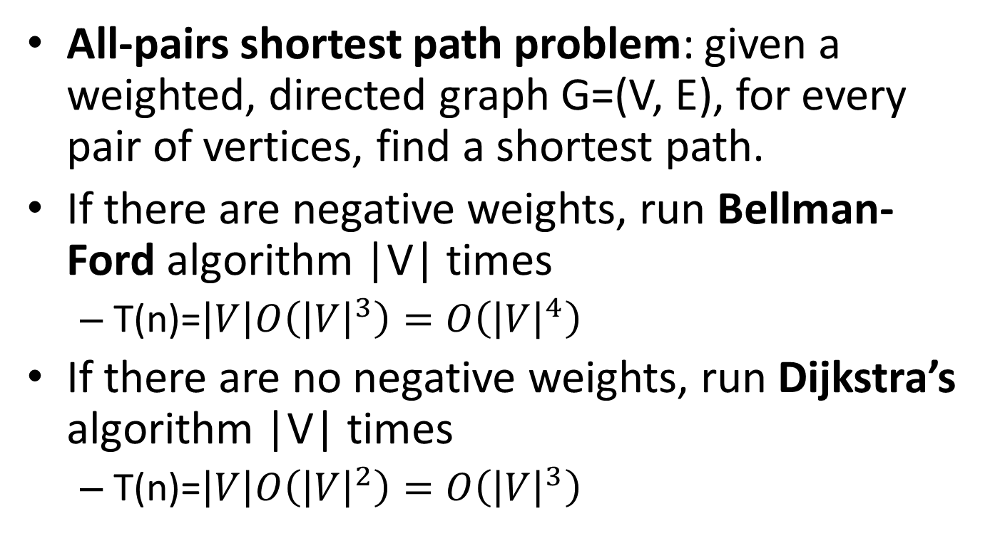
All-pairs shortest paths
All-pairs shortest path problem: given a weighted, directed graph G=(V, E), for every pair of vertices, find a shortest path.
If there are negative weights, run Bellman-Ford algorithm |V| times
T(n)=$\left|V\right|O\left({\left|V\right|}^{3}\right)=O\left({\left|V\right|}^{4}\right)$
If there are no negative weights, run Dijkstra’s algorithm |V| times
T(n)=$\left|V\right|O\left({\left|V\right|}^{2}\right)=O\left({\left|V\right|}^{3}\right)$

Slide 3
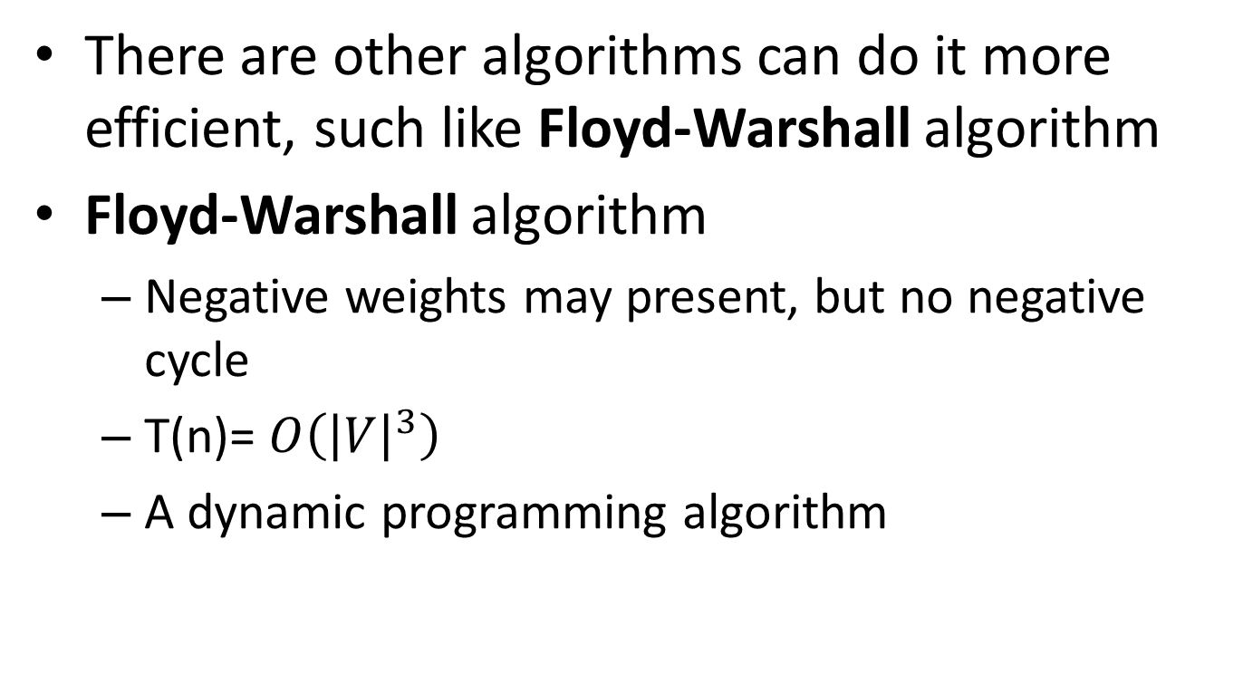
All-pairs shortest paths
There are other algorithms can do it more efficient, such like Floyd-Warshall algorithm
Floyd-Warshall algorithm
Negative weights may present, but no negative cycle
T(n)= $O\left({\left|V\right|}^{3}\right)$
A dynamic programming algorithm

Slide 4
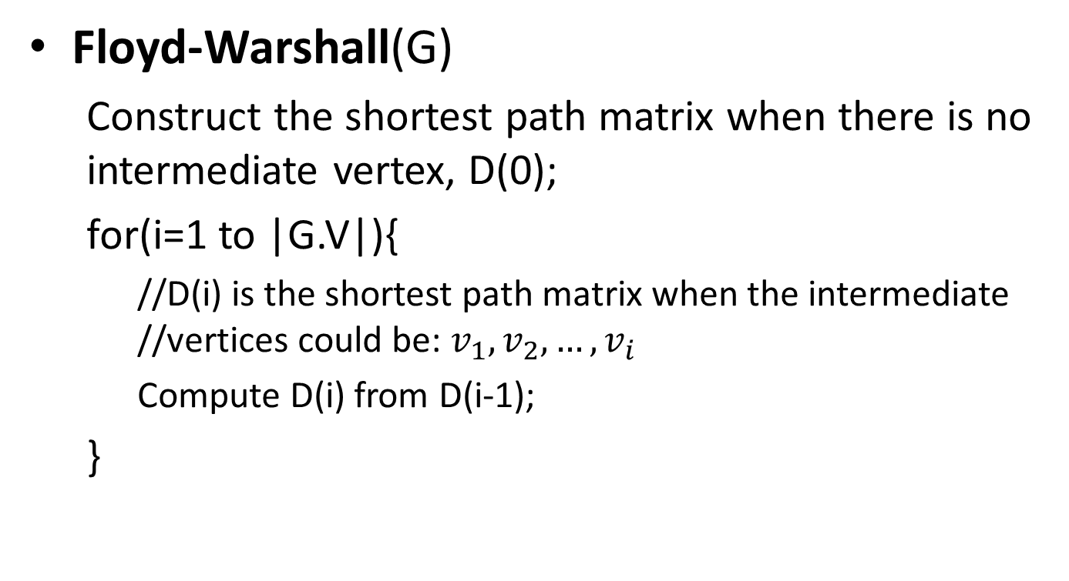
All-pairs shortest paths
Floyd-Warshall(G)
Construct the shortest path matrix when there is no intermediate vertex, D(0);
for(i=1 to |G.V|){
//D(i) is the shortest path matrix when the intermediate //vertices could be: $v_{1},v_{2}, …,v_{i}$
Compute D(i) from D(i-1);
}

Slide 5










All-pairs shortest paths
What are the weights of shortest paths with no intermediate vertices, D(0)?
1
2
 | 1 | 2 | 3 | 4
1
2
3
4
9
3
0
$$∞$$
$$∞$$
$$∞$$
6
4
$$∞$$
$$0$$
$$∞$$
4
3
$$9$$
$$0$$
2
3
4
$$∞$$
6
$$∞$$
0
2

Slide 6















All-pairs shortest paths
D(0)
 | 1 | 2 | 3 | 4
1
2
3
4
0
$$∞$$
$$∞$$
$$∞$$
1
2
$$∞$$
0
$$∞$$
4
3
2
0
9
2
$$∞$$
6
$$∞$$
0
3
6
4
What are the weights of shortest paths with intermediate vertex 1?
3
4
D(1)
 | 1 | 2 | 3 | 4
1
2
3
4
9
0
$$∞$$
$$∞$$
$$∞$$
$$∞$$
0
$$∞$$
4
3
$$2$$
0
9
$$∞$$
6
$$∞$$
0

Slide 7












All-pairs shortest paths
D(1)
 | 1 | 2 | 3 | 4
1
2
3
4
0
$$∞$$
$$∞$$
$$∞$$
1
2
$$∞$$
0
$$∞$$
4
3
$$2$$
0
9
2
$$∞$$
6
$$∞$$
0
3
4
6
4
What are the weights of shortest paths with intermediate vertices 1 and 2?
3
4
D(2)
 | 1 | 2 | 3 | 4
1
2
3
4
9
0
$$∞$$
$$∞$$
$$∞$$
$$∞$$
0
$$∞$$
4
3
$$2$$
0
6
$$∞$$
6
$$∞$$
0

Slide 8
















All-pairs shortest paths
D(2)
 | 1 | 2 | 3 | 4
1
2
3
4
0
$$∞$$
$$∞$$
$$∞$$
1
2
$$∞$$
$$∞$$
0
4
3
$$2$$
0
6
2
3
$$∞$$
6
$$∞$$
0
6
4
What are the weights of shortest paths with intermediate vertices 1, 2 and 3?
3
4
D(3)
 | 1 | 2 | 3 | 4
1
2
3
4
9
0
$$∞$$
$$∞$$
$$∞$$
$$∞$$
0
$$∞$$
4
3
$$2$$
0
6
$$∞$$
6
$$∞$$
0

Slide 9





All-pairs shortest paths
D(3)
 | 1 | 2 | 3 | 4
1
2
3
4
0
$$∞$$
$$∞$$
$$∞$$
1
2
$$∞$$
0
$$∞$$
4
3
$$2$$
0
6
2
$$∞$$
6
$$∞$$
0
3
6
4
What are the weights of shortest paths with intermediate vertices 1, 2, 3 and 4?
3
D(4)
4
 | 1 | 2 | 3 | 4
1
2
3
4
9
0
$$∞$$
$$∞$$
$$∞$$
$$∞$$
0
$$∞$$
4
3
$$2$$
0
6
$$∞$$
6
$$∞$$
0

Slide 10
































All-pairs shortest paths
Add predecessor information to reconstruct a shortest path
If updated the predecessor i-j in D(k) is the same as the predecessor k-j in D(k-1)
D(0)
D(1)
 | 1 | 2 | 3 | 4
1
2
3
4
 | 1 | 2 | 3 | 4
1
2
3
4
0/n
$$∞/n$$
$$∞/n$$
$$∞/n$$
0/n
$$∞/n$$
$$∞/n$$
$$∞/n$$
$$∞/n$$
0/n
$$∞/n$$
4/2
$$∞/n$$
0/n
$$∞/n$$
4/2
3/3
$$2/3$$
0/n
9/3
3/3
$$2/3$$
0/n
9/3
$$∞/n$$
6/4
$$∞/n$$
0/n
$$∞/n$$
6/4
$$∞/n$$
0/n
D(2)
D(3)
 | 1 | 2 | 3 | 4
1
2
3
4
 | 1 | 2 | 3 | 4
1
2
3
4
0/n
$$∞/n$$
$$∞/n$$
$$∞/n$$
0/n
$$∞/n$$
$$∞/n$$
$$∞/n$$
$$∞/n$$
0/n
$$∞/n$$
4/2
$$∞/n$$
0/n
$$∞/n$$
4/2
3/3
$$2/3$$
0/n
6/2
3/3
$$2/3$$
0/n
6/2
$$∞/n$$
6/4
$$∞/n$$
0/n
$$∞/n$$
6/4
$$∞/n$$
0/n

Slide 11








All-pairs shortest paths
D(4)
1
2
 | 1 | 2 | 3 | 4
1
2
3
4
0/n
$$∞/n$$
$$∞/n$$
$$∞/n$$
2
$$∞/n$$
4/2
3
$$∞/n$$
0/n
6
4
3/3
$$2/3$$
0/n
6/2
$$∞/n$$
6/4
$$∞/n$$
0/n
3
4
9
What is the shortest path from 3 to 4?
3, 2, 4
What is weight of this path?
6

Slide 12
Remarks
Floyd’s algorithm solves for the shortest path among all pairs of vertices.
https://youtu.be/4OQeCuLYj-4

